Slide 1
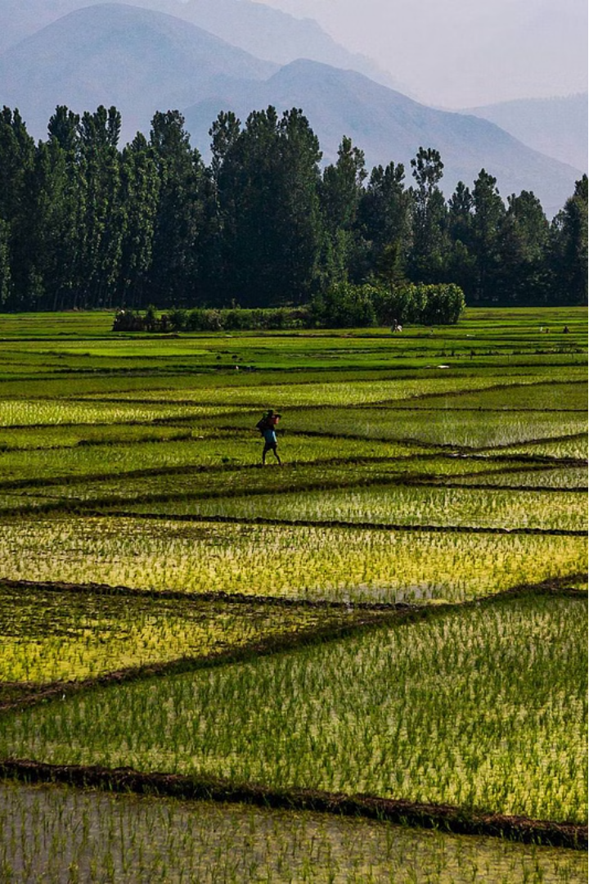

India's Thriving Agricultural Sector
India is one of the world's largest agricultural producers, with the sector contributing significantly to the country's GDP and employing a majority of the workforce. This presentation will explore the key aspects of India's vibrant agricultural landscape.

Slide 2
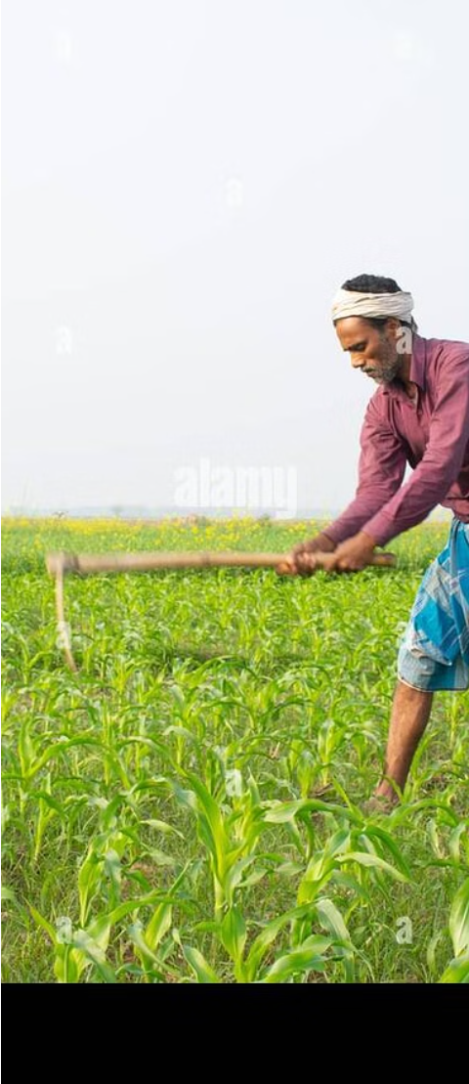
Workforce Reliance on Agriculture
1
Dominant Employer
2
Sustaining Millions
Around 59% of India's total workforce is engaged in farming, demonstrating the sector's crucial role in providing livelihoods.
The agriculture sector remains a vital source of income and employment for millions of people across India.
3
Economic Importance
The agricultural sector's significance extends beyond just employment, as it is a critical part of the Indian economy.

Slide 3
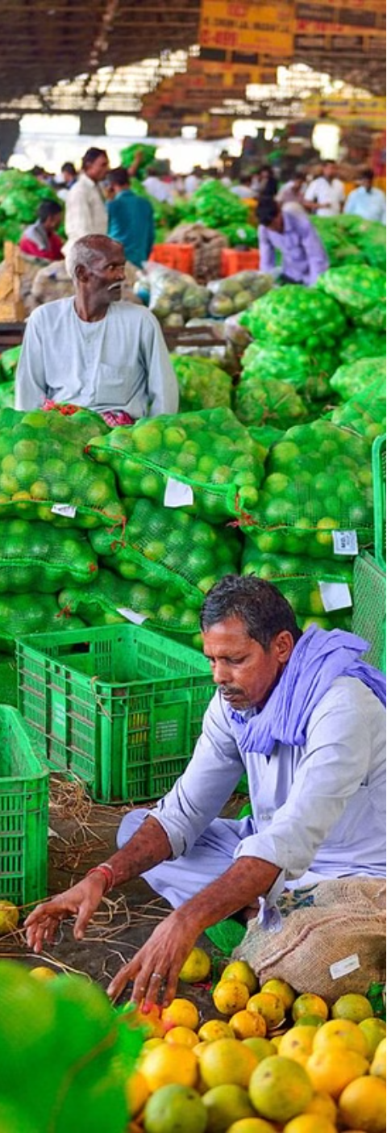
Expanding Agricultural Market
1
Current Market Size
In 2023, the Indian agricultural sector's market size reached approximately INR 71,220 billion.
2
Projected Growth
The market is expected to grow to around INR 142,280 billion by 2027, exhibiting a CAGR of 12.23% during 2021-2027.
3
Driving Factors
The expansion of the agricultural market is fueled by factors such as population growth, rising incomes, and increasing demand for food products.

Slide 4
Top Crop-Producing States
1
Potatoes
2
Tomatoes
Leading potato-producing states: Uttar Pradesh, West Bengal, Bihar, and Gujarat.
Major tomato-producing states: Andhra Pradesh, Madhya Pradesh, Karnataka, and others.
3
Onions
4
Wheat
Top onion-producing states: Maharashtra, Madhya Pradesh, Karnataka, and Gujarat.
Leading wheat-producing states: Uttar Pradesh, Madhya Pradesh, Punjab, Haryana, and Rajasthan.

Slide 5
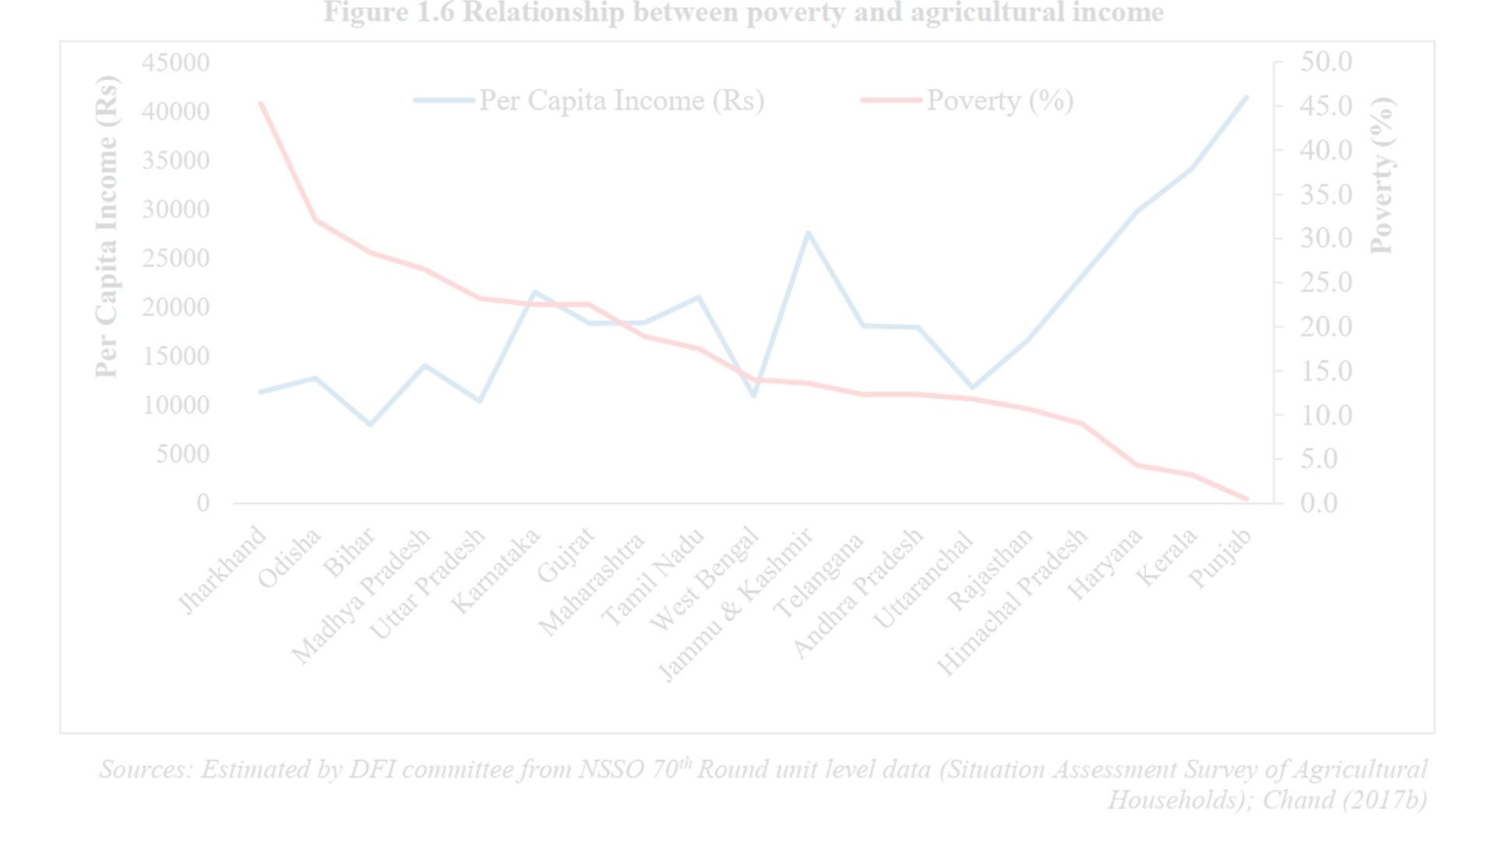
Rising Incomes in Agriculture
Increased Earnings
Economic Progress
Sustainable Growth
The average monthly income per agricultural household in India stood at Rs 10,218 in 2019, up from Rs 6,426 in 2014.
The rise in agricultural incomes reflects the sector's growing prosperity and its ability to provide better livelihood opportunities.
Improving the financial well-being of farmers is crucial for the long-term sustainability and development of the agricultural sector.

Slide 6


Slide 16




Future Outlook
Modernization
Ongoing technological advancements will drive further modernization and efficiency in the agricultural sector.
Sustainable Practices
Increased focus on sustainable farming methods will promote environmental stewardship and long-term viability.
International Trade
Expanding export opportunities will further boost the Indian agricultural sector's global competitiveness.

